Slide 1
SOAL 2
Timotius KElvin

Slide 2
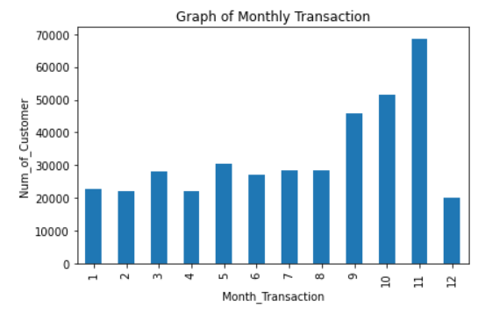
What can you say about the monthly transactions?
As you can from this chart
The total the transaction increased up at its peak when November and decreased when its get to the December.
It seems it can be a cycle when December is the lowest and start climbing at January and get its Peak at November.

Slide 3
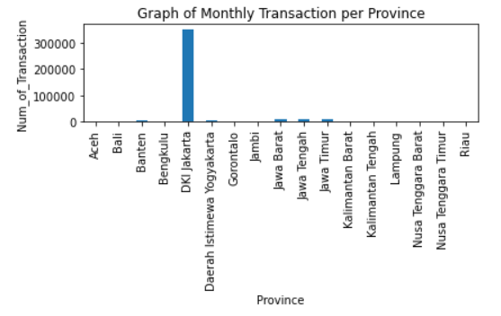
As business users, what metrics/variables should we look at?
The most Importance part is to look at unit_price, quantity, and province from my opinion
Because the unit_price can show how much the transaction is.
Quantity also show the amount of transaction.
Transaction value = unit_price x quantity
Then, the province can show which region got big transaction or low transaction.
Shown at this graph

Slide 4
With the data at hand, tell us what you know or what you can find out.
I know the Monthly transaction. How many transaction each month
I know the distribution of transaction per province
I know which customer spent the most transaction
I will find out the which product attract more costumer to purchase/transfers

Slide 5
If you must prioritize your action plans, what will be your top 3? Give your reason to us!
I will focus my business at special region especially at DKI Jakarta which has the most transaction
I will start focus selling my product at November because it has the highest transaction. Many costumer do the transaction at that month.
I will look which product at ‘description’ that customer always purchase or transaction. I will put some good promo sales at that things.

